Slide 1
Lending Club Case Study
Group : Sushma and Subham Bansal

Slide 2
Problem Statement
Apply risk analytics in banking and financial services on data that institution has collected tracked as history of loans.
Main objective to prevent or define the parameters by which out client can identity a risky customer who most likely to defaults in repayment of loan such that can avoid lending money in order to save money and mitigate credit risk
We as a data analyst expected here to identify the main driving variables using which can identify a defaulter matric form raw data after applying EDA
To learn and understand how data is used to minimise the risk of losing money while lending to customers for financial system
01

Slide 3
Strategy Followed
Clean Data
Univariate Analysis
Segmented Univariate Analysis
- Drop columns with null values, all random values or single category value - Convert values to proper int, float, date representations
- Check distributions and frequencies of various numerical and categorical variables
- Create derived variables
- Analyze variables against segments of other variables
- Create derived variables
Bi-Variate Analysis
Graph Plot
Publish Insights
- Do correlation analysis Check how two variables affect each other or a third variable -- Analyze joint distributions
Plot the graph and analysis to get the hidden insight of the data
Publish insights and observations

Slide 4
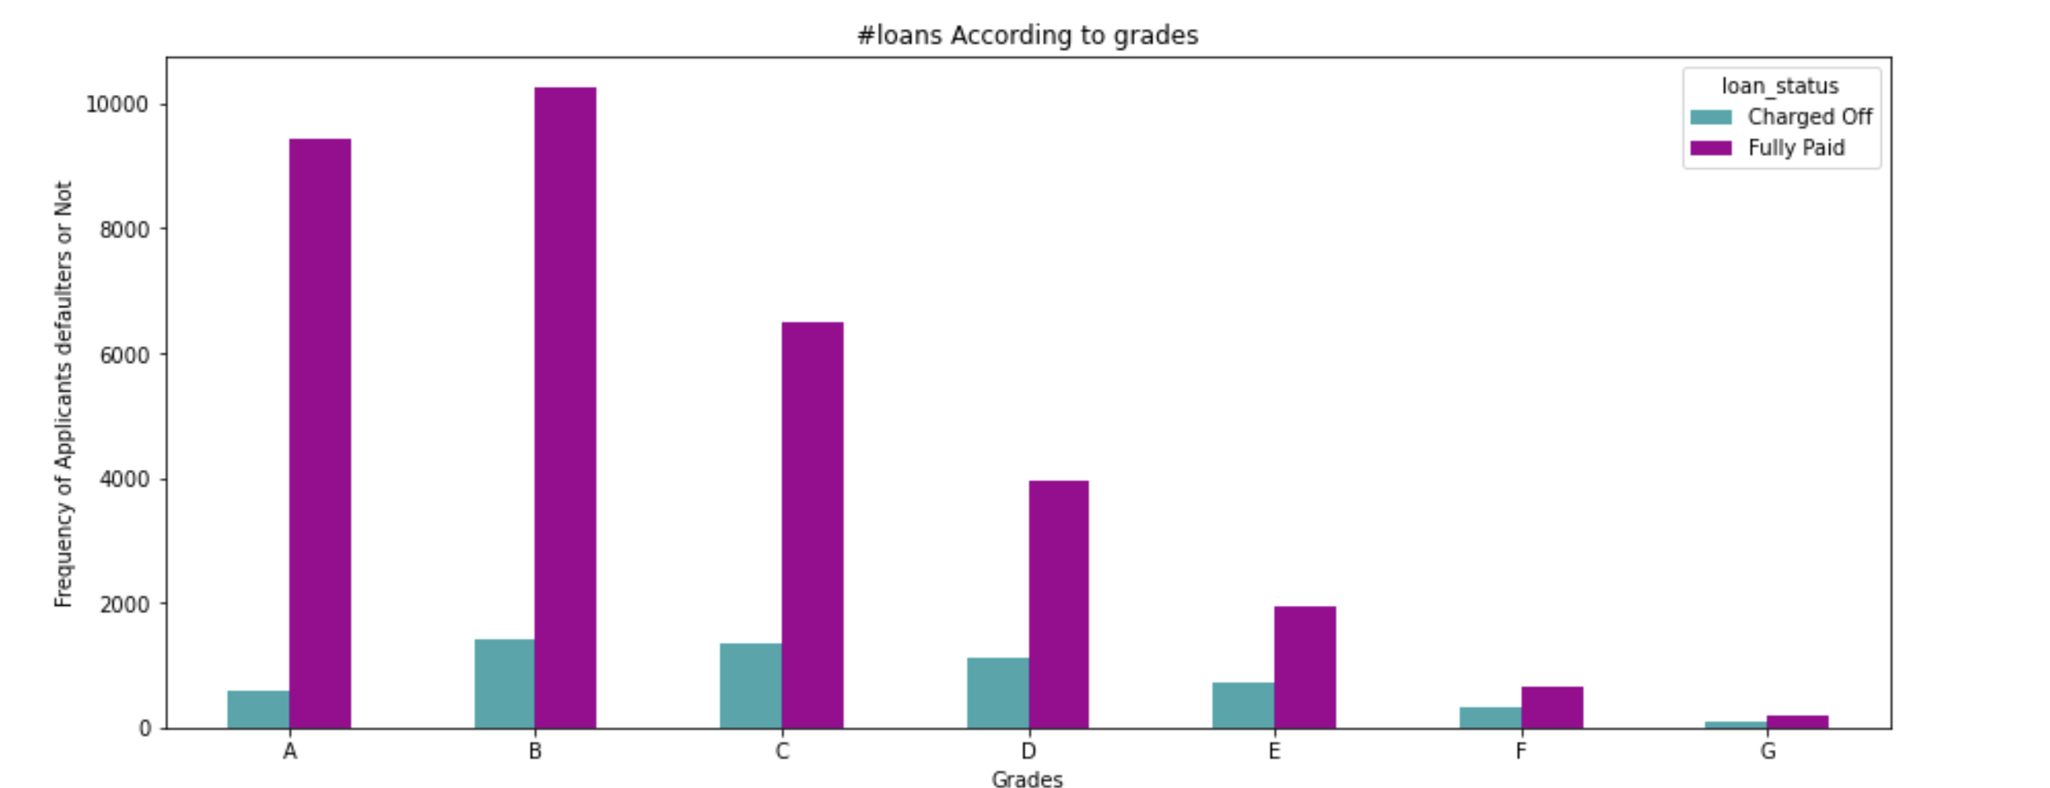
Analysis: univariant
Sdasas
Dsa
D
Sad
Sada
Da
Dsa
Ad
Ad
Sad
01

Slide 5
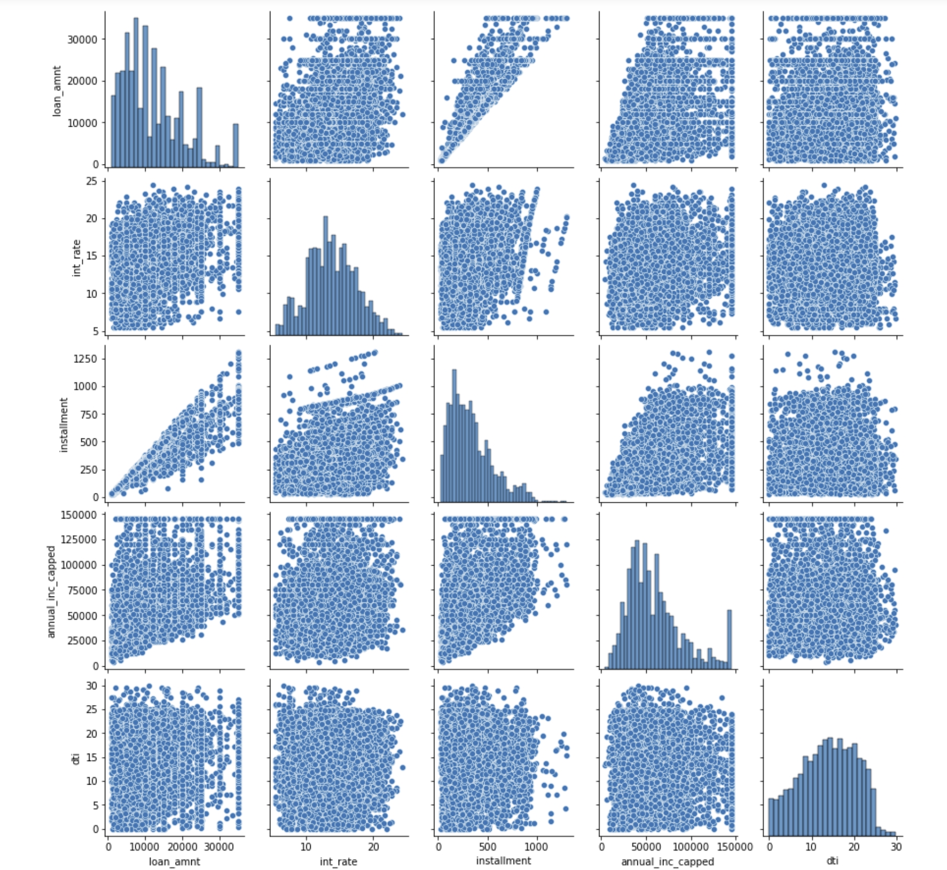
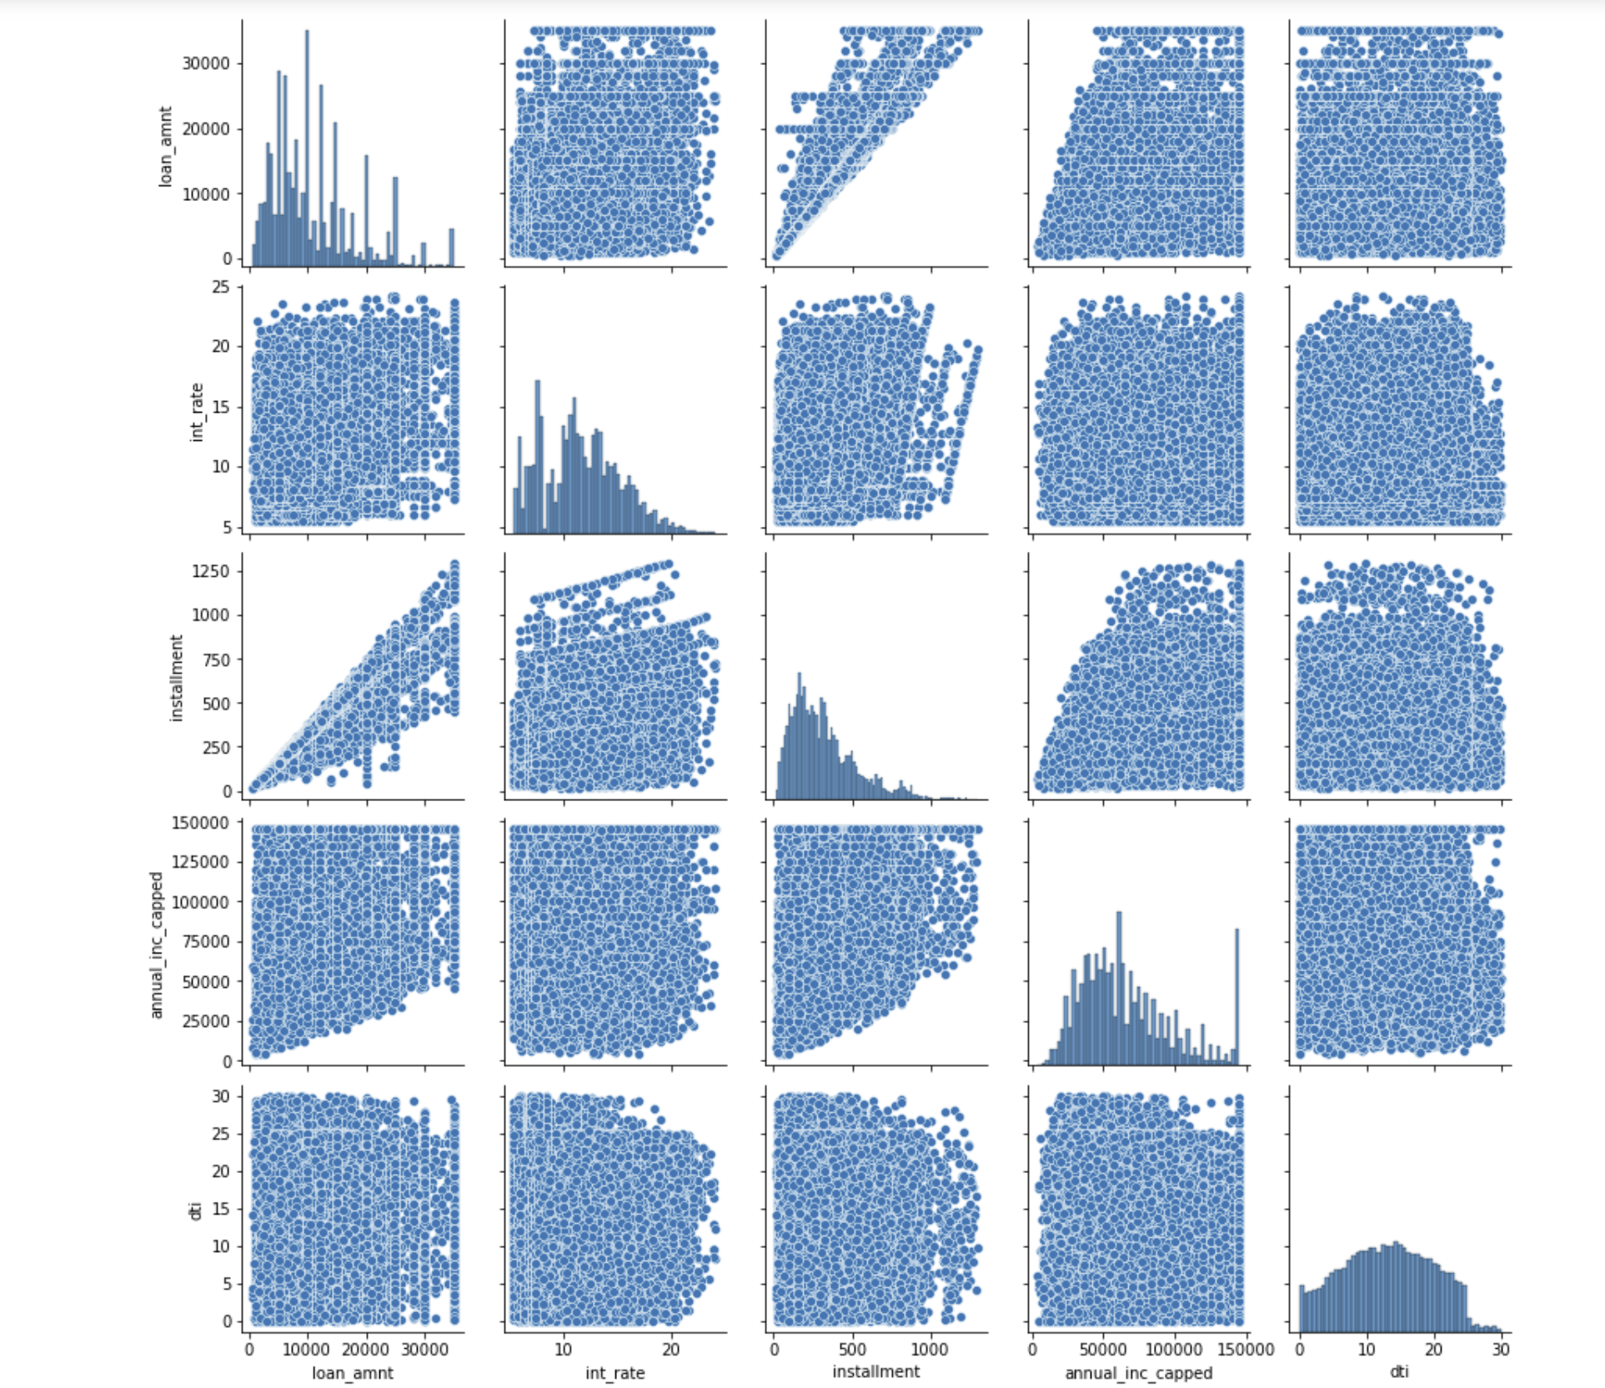
Bi-variarte
01
Installment , income and loan amount highly corelated for both the case for including fully charge and charged off

Slide 6
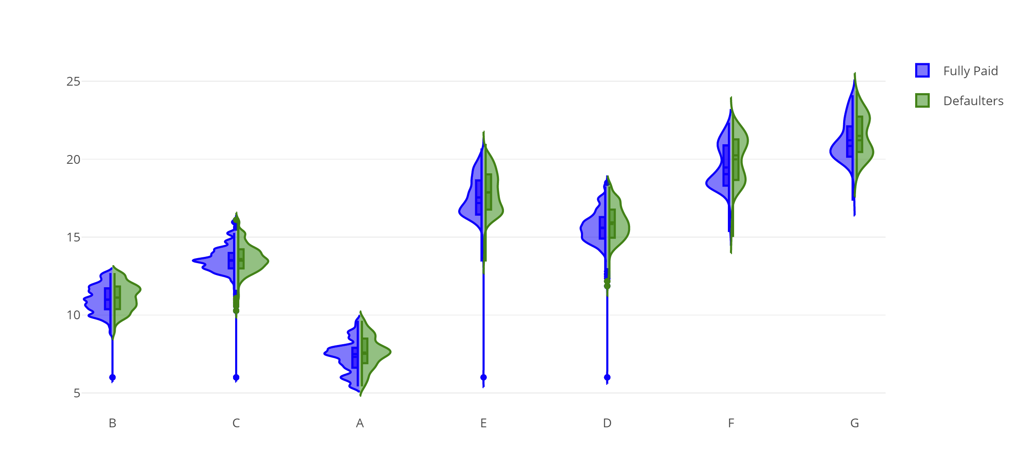
Bi-variarte
01
# Interst rates grows linearly with grade from A to G.

Slide 7
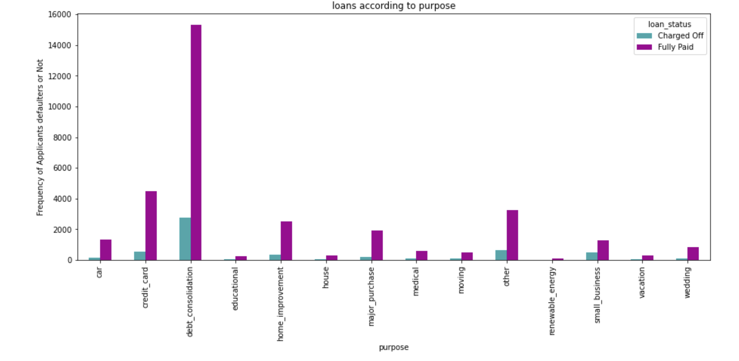
Analysis - Overall Loan Status
01
Dsa
Da
ds

Slide 8
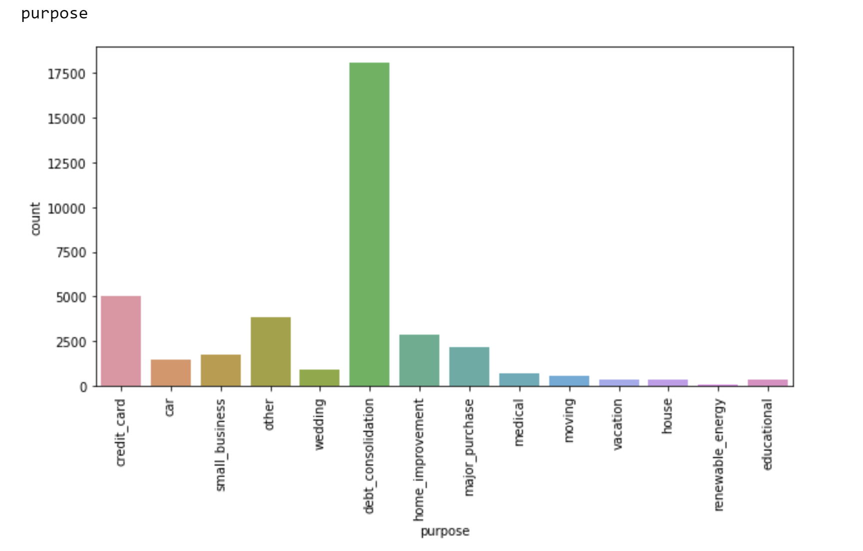
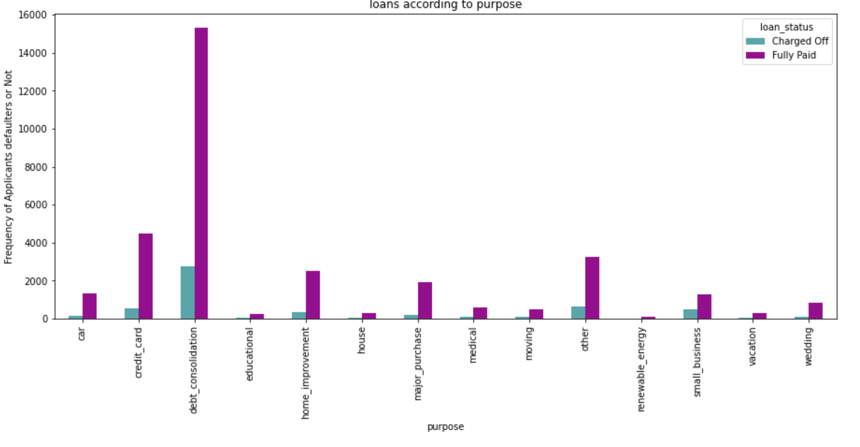
Analysis: Loan Types
01
Dsaaasd
A
Dsa
Daa
sd
Dsaaasd
A
Dsa
Daa
sd

Slide 9
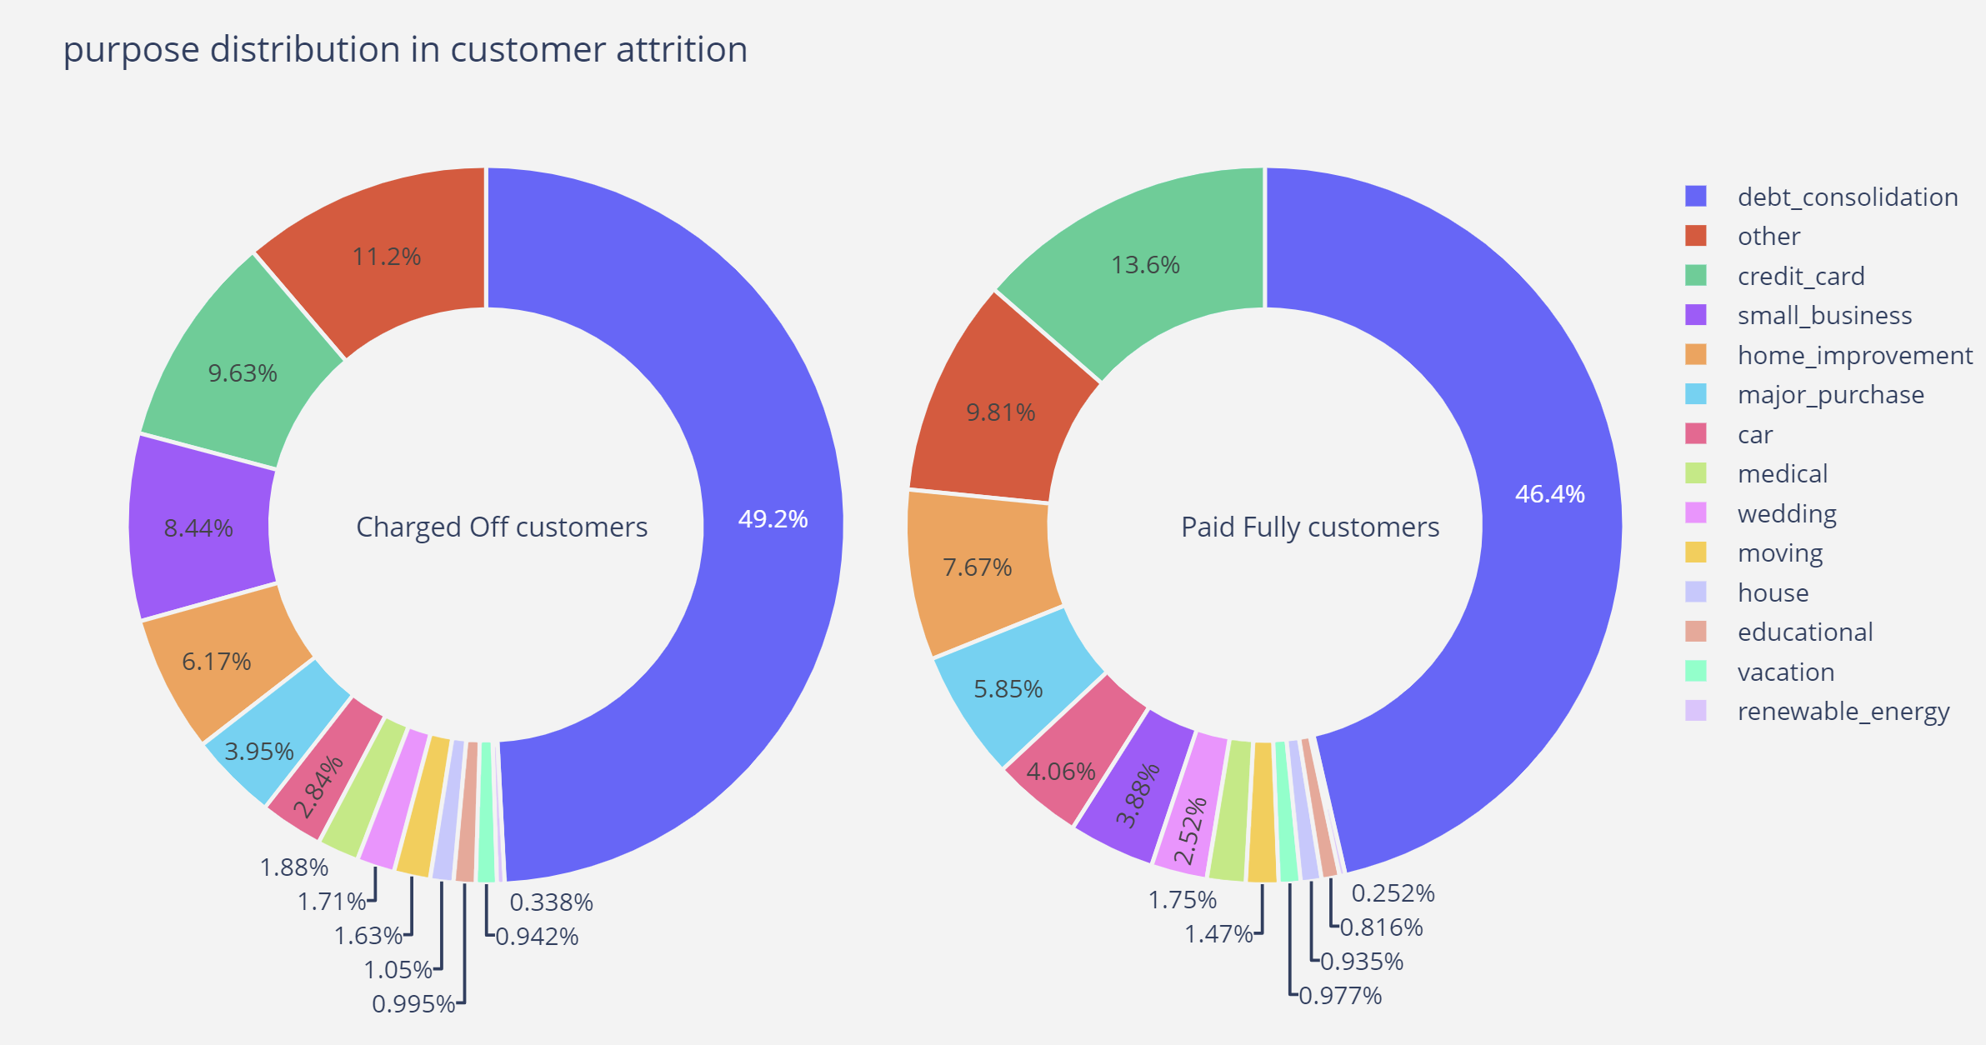
Problem Statement
01
Apply risk analytics in banking and financial services on data that institution has collected tracked as history of loans.
financial system

Slide 10
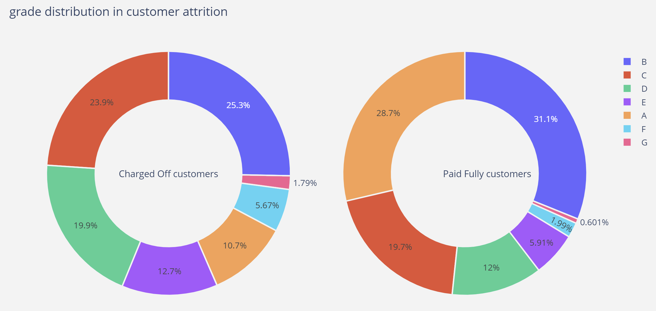
Problem Statement
01
Apply risk analytics in banking and financial services on data that institution has collected tracked as history of loans.
financial system

Slide 11
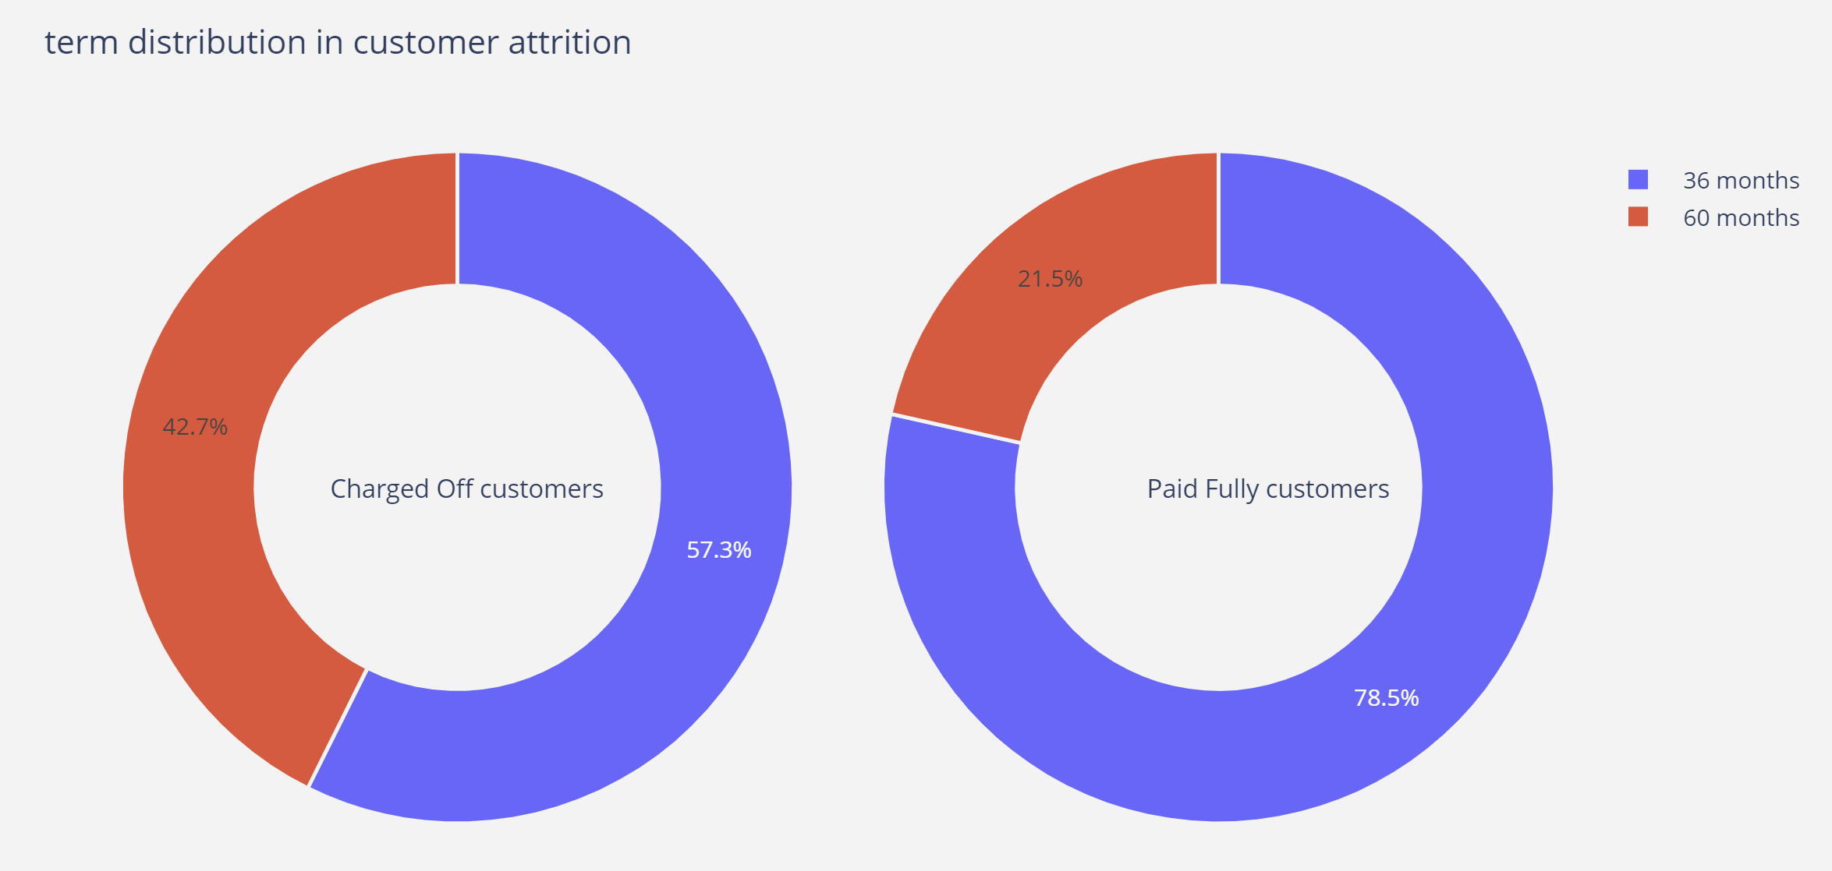
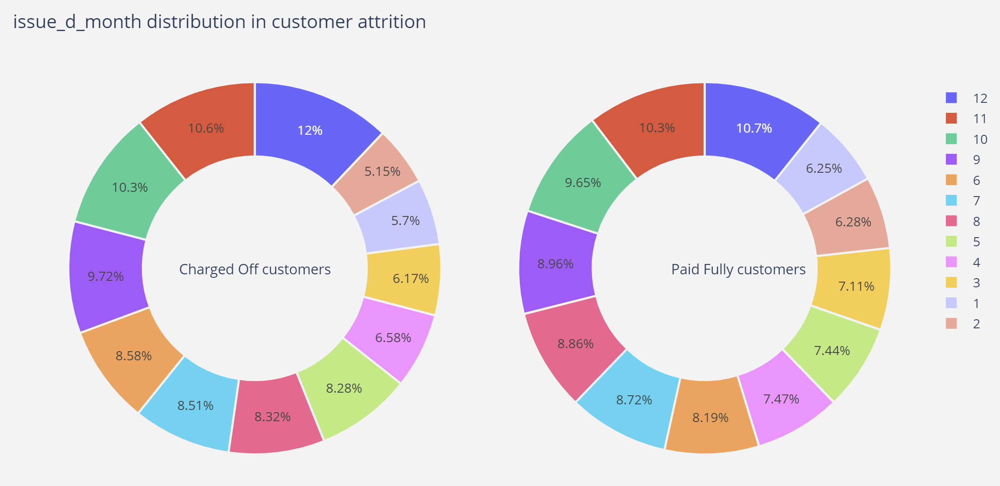
Problem Statement
01
Apply risk analytics in banking and financial services on data that institution has collected tracked as history of loans.
financial system

Slide 12
Problem Statement
01
Apply risk analytics in banking and financial services on data that institution has collected tracked as history of loans.
financial system

Slide 13
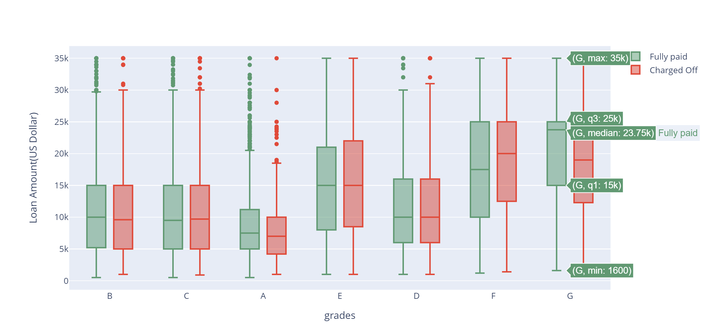
Draft
01
# Loan applicants who fall under grade G -are mostly going to be non-defaulters even when loan amount reuested is high

Slide 14
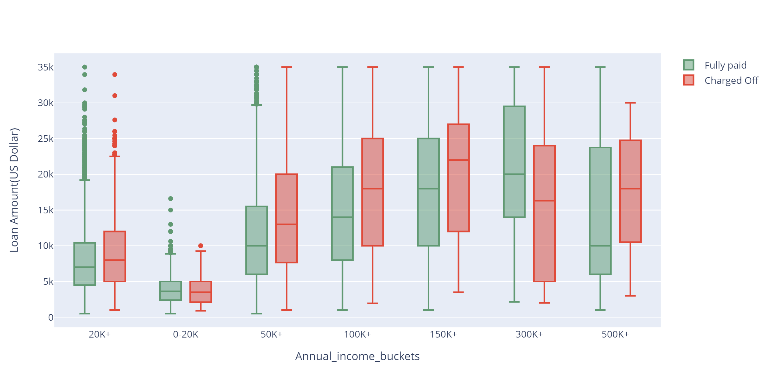
Done
01
# The applicants have annual income between 50K to 150K are more likely to be defauters when thier Loan amount requested is higher than 7K
# Also we can notice that Borrowers whose income in 300K+ are most likely to be non defaulters even though the loan amount requested is higher, adding more value to business

Slide 15
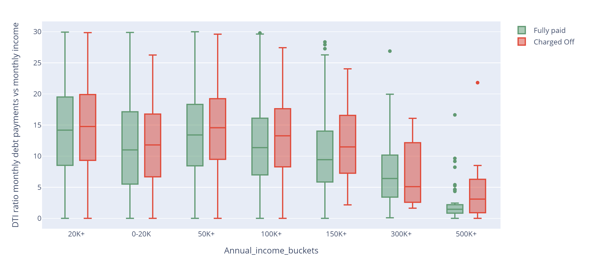
Done
01
# Applicants whose DTI is lower ranging from [0-8.5] and thier annual income is 500K+ are likely to be defaulted.
# More the annual income but thier DTI ratio is lesser , they are more likely to be defaulters

Slide 16
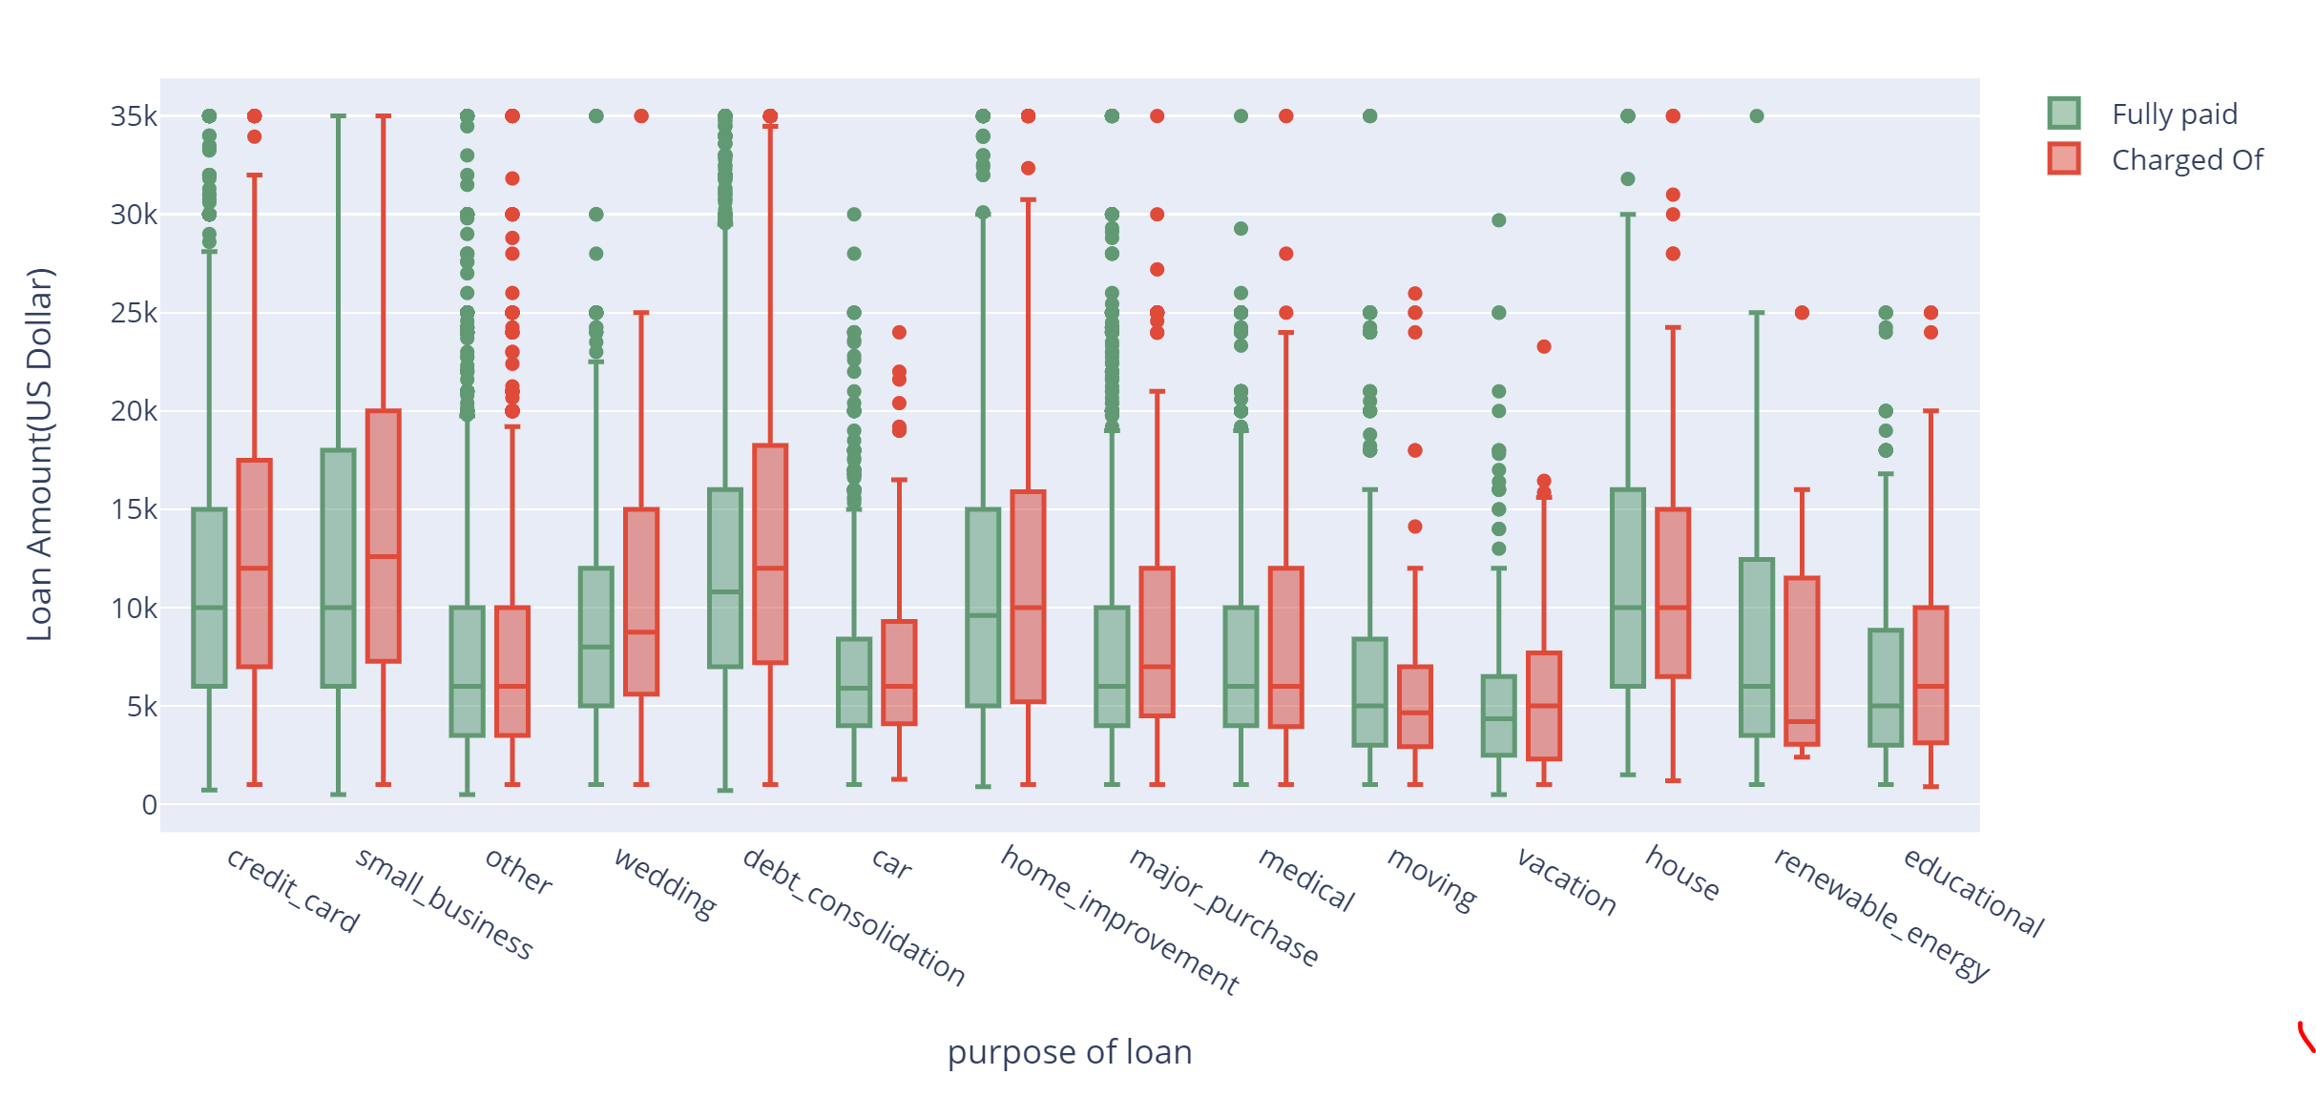
Draft -
01
Customer asking loan for debt repayment of credit card payemt are most likely to get default

Slide 17
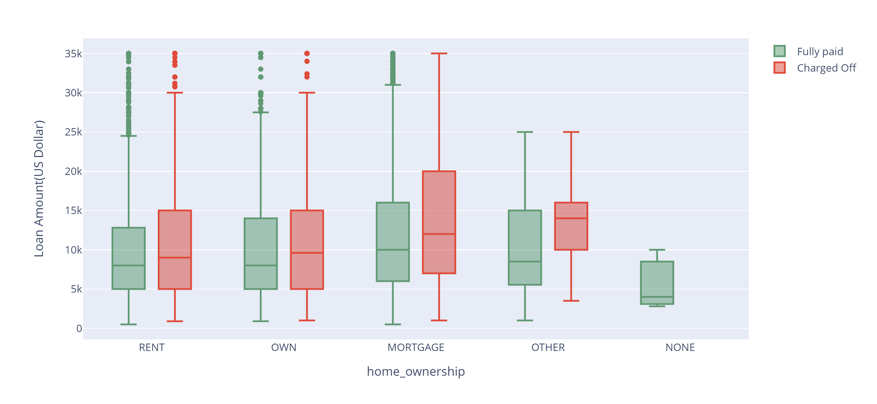
Done
01
# Loan applicants who has Mortgage property is tend to be defaulter when higher loan amount is requested

Slide 18
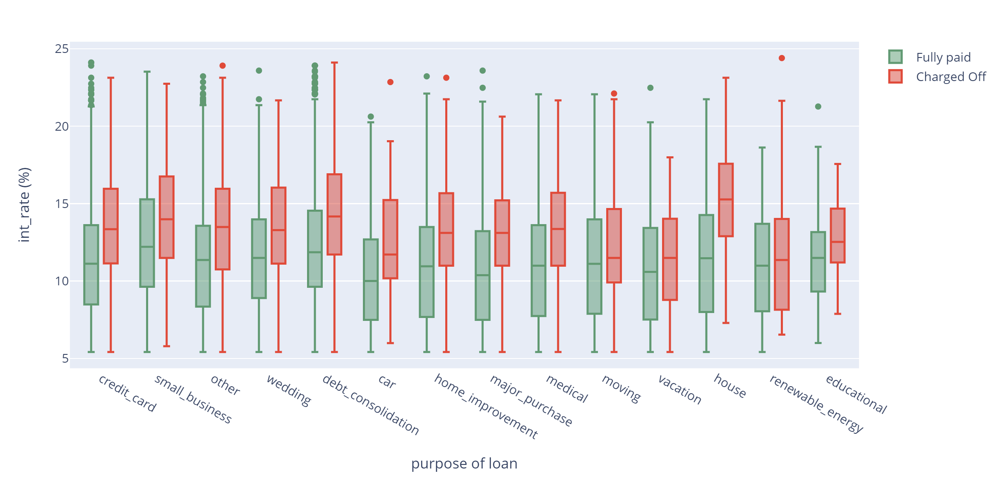
Done
01
Customer provided housing loan on a higher interest rate(around 15%) are most likely to be charged off. Generally, if interest rates are higher than usual for a particular purpose of loan, its more likely that, applicant will be a defaulter
Similar trend observed for debt consolidation as well

Slide 19
Conclusion on Insight Revealed

Slide 20
Results:
# customer who apply for 36 months term most likely to pay in full so we can avoid customer ask for 60 months
# - Loan applicants who fall under grade G -are mostly going to be non-defaulters even when loan amount requested is high
# The applicants have annual income between 50K to 150K are more likely to be defaulters when their Loan amount requested is higher than 7K
# we can notice that Borrowers whose income in 300K+ are most likely to be non defaulters even though the loan amount requested is higher, adding more value to business
# Applicants whose DTI is lower ranging from [0-8.5] and their annual income is 500K+ are likely to be defaulted.
# More the annual income but their DTI ratio is lesser , they are more likely to be defaulters
# -Customer asking loan for debt repayment of credit card payment are most likely to get default
# Loan applicants who has Mortgage property is tend to be defaulter when higher loan amount is requested
# Customer provided housing loan on a higher interest rate(around 15%) are most likely to be charged off. Generally, if interest rates are higher than usual for a particular purpose of loan, its more likely that, applicant will be a defaulter
Similar trend observed for debt consolidation as well
# Interest rates grows linearly with grade from A to G.
01

Slide 21
Thank You…

